Slide 1


Bay Bridges
Abhishek Gupta

Slide 2
AGENDA
TERMINOLOGY
OVERVIEW
SOLUTION
TOOLS

Slide 3
TERMINOLOGY
Line = Bridge Coordinate = Point
List = Array
Notes:
I didn’t really understand the scope of the problem, but I understood the math. I treated a bridge as a line and point as coordinate and labelled them as such in my program. It was easier for me to understand.
You can think of Python lists as arrays even though there are slight differences (i.e. Python lists can hold a variety of datatypes).

Slide 4
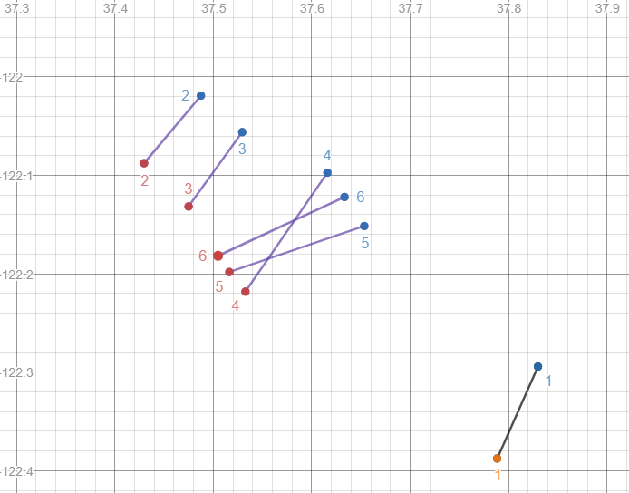
OVERVIEW
OUTPUT: 1 2 3 5 6
Notes:
The goal of the problem is to find the largest set of lines where no intersection exists. So we cannot simply throw out a line if it has an intersection.
The output is 1 2 3 5 6.

Slide 5
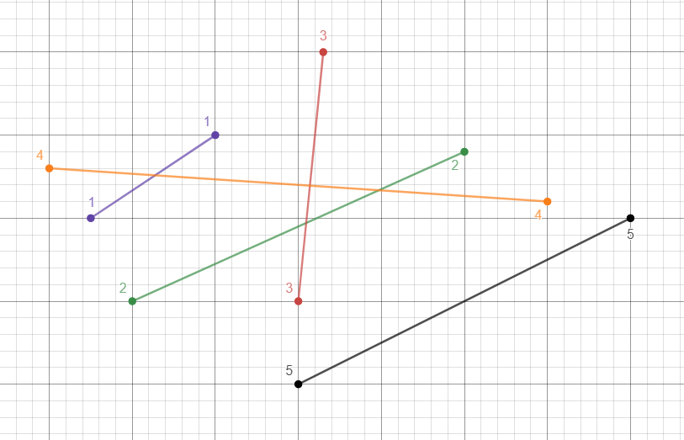
SOLUTION – Solving a Custom Example
Notes:
I’m going to go over a custom example. I will either draw this on the board or add more slides detailing step-by-step what is going on.

Slide 6
SOLUTION – Solving a Custom Example
lines = [Line(index, Coordinate(x1, y1), Coordinate(x2, y2))]
lines = [1, 2, 3, 4, 5]
Notes:
After program reads input, all lines will be stored in a list. Each line is an object that holds an index position and 2 coordinate objects. For the sake of brevity, we are going to represent this list by just the indices. So just know that this second lines list where we have 1, 2, 3, 4, 5, each of these are actually objects. I only wrote it like this so it’s easier to see.

Slide 7
SOLUTION – Solving a Custom Example
Create an empty list called lines_without_intersections (lwi) = []
Entering infinite loop. End when lines length is 0.
lines = [ 1, 2, 3, 4, 5 ] max_intersections = 0 max_line = None
1 has 1 intersection max_intersections = 1 max_line = Line 1 object

Slide 8
SOLUTION – Solving a Custom Example
lines = [ 1, 2, 3, 4, 5 ] max_intersections = 1 max_line = Line 1 object
2 has 2 intersections max_intersections = 2 max_line = Line 2 object

Slide 9
SOLUTION – Solving a Custom Example
lines = [ 1, 2, 3, 4, 5 ] max_intersections = 2 max_line = Line 2 object
3 has 2 intersections max_intersections = 2 max_line = Line 3 object

Slide 10
SOLUTION – Solving a Custom Example
lines = [ 1, 2, 3, 4, 5 ] max_intersections = 2 max_line = Line 3 object
4 has 3 intersections max_intersections = 3 max_line = Line 4 object

Slide 11
SOLUTION – Solving a Custom Example
lines = [ 1, 2, 3, 4, 5 ] max_intersections = 3 max_line = Line 4 object
5 has 0 intersections lwi = [5]

Slide 12
SOLUTION – Solving a Custom Example
Does max_line hold something? max_intersections = 3 max_line = Line 4 object
lines = [1, 2, 3, 5]

Slide 13
SOLUTION – Solving a Custom Example
What values are in lwi that are also in lines?
lines = [1, 2, 3, 5] lwi = [5]
lines = [1, 2, 3]

Slide 14
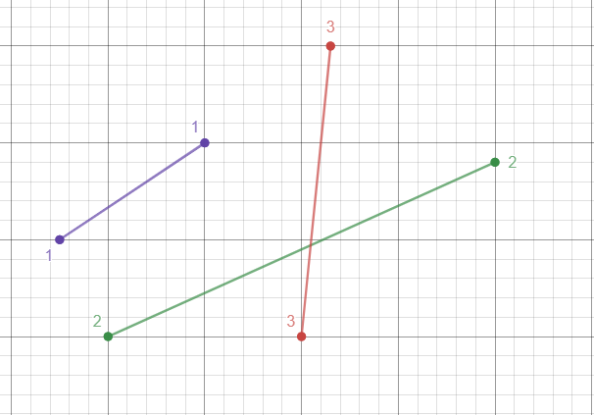
SOLUTION – Solving a Custom Example
lines = [1, 2, 3]

Slide 15
SOLUTION – Solving a Custom Example
lines = [ 1, 2, 3 ] max_intersections = 0 max_line = None
1 has 0 intersections lwi = [5, 1]

Slide 16
SOLUTION – Solving a Custom Example
lines = [ 1, 2, 3 ] max_intersections = 0 max_line = None
2 has 1 intersection max_intersections = 1 max_line = Line 2 object

Slide 17
SOLUTION – Solving a Custom Example
lines = [ 1, 2, 3 ] max_intersections = 1 max_line = Line 2 object
3 has 1 intersection max_intersections = 1 max_line = Line 3 object

Slide 18
SOLUTION – Solving a Custom Example
Does max_line hold something? max_intersections = 1 max_line = Line 3 object
lines = [1, 2, 3] → lines = [1, 2]

Slide 19
SOLUTION – Solving a Custom Example
What values are in lwi that are also in lines?
lines = [1, 2] lwi = [5, 1]
lines = [2]

Slide 20
SOLUTION – Solving a Custom Example
lines = [ 2 ] max_intersections = 0 max_line = None
2 has 0 intersections lwi = [5, 1, 2]

Slide 21
SOLUTION – Solving a Custom Example
Does max_line hold something? max_intersections = 0 max_line = None
lines = [2] → lines = [2]

Slide 22
SOLUTION – Solving a Custom Example
What values are in lwi that are also in lines?
lines = [2] lwi = [5, 1, 2]
lines = [] ← lines length is now 0, break out of infinite loop.

Slide 23
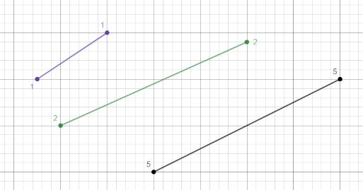
SOLUTION – Solving a Custom Example
lwi = [5, 1, 2] → INSERTION SORT → lwi = [1, 2, 5]
OUTPUT:
1 2 5

Slide 24





Notes:
Python 3 for the program. Git for version control. GitHub for repository hosting.
Cloud9 for integrated development environment.
Desmos for graphing (easy visualization for other outputs).

